Slide 1


Intro to Data Science & AI
A Comprehensive 2-Hour Intensive Session Theory (1 Hr) | Practical Lab & Discussion (1 Hr)

Slide 2


Daily Session Structure
Daily Theory Session
Daily Practical Lab & Discussion
•
Definition, Scope & Value of Data Science
•
Interactive Coding: Jupyter & Google Colab Setup
•
End-to-End Data Science Lifecycle
•
Configuring Virtual Environments & Package Managers
•
Core AI Taxonomy: AI vs. ML vs. DL vs. GenAI
•
Introduction to Python Data Science Stack
•
Overview of Supervised, Unsupervised & Reinforcement Learning
•
Real-World AI/DS Industry Case Studies
•
Group Discussion & Ethical AI Considerations
•
Roles & Skillsets in Modern Data Teams

Slide 3

Daily Theory (1 Hour)
Foundations, Scope, Lifecycle & Paradigm Hierarchy

Slide 4


What is Data Science?
Core
The 3 Key Pillars
Data science is the study of data used to extract meaningful insights for business decisions. The key process involves collecting, cleaning, analysing, and interpreting data to solve real-world problems and support better decision-making.
1. Mathematics & Statistics: Hypothesis testing, probability, probability distributions, linear algebra.
2. Computer Science & Software: Python, R, SQL, algorithmic complexity, data structures.
3. Business & Domain Expertise: Asking the right business questions and interpreting analytical outputs.

Slide 5


The Data Science Lifecycle
Business Problem
Data Collection
Data Cleaning
Data Analysis
Model Building
Every successful Data Science project follows this structured lifecycle — from understanding the business problem all the way through to continuous monitoring and improvement of the deployed solution.

Slide 6

Data Collection, Processing & Visualization
Data Collection Sources
Data Analysis Purpose
Databases, Websites & APIs
Excel files & IoT Sensors
Social Media platforms
Find patterns & discover trends
Answer business questions
Data Processing
Common Chart Types
Remove duplicates
Handle missing values
Correct errors & standardize formats
Bar Chart & Line Chart
Pie Chart & Scatter Plot
Histogram
Benefits
Garbage In = Garbage Out. Clean data leads to better results.
Easy to understand and supports better business decisions.

Slide 7
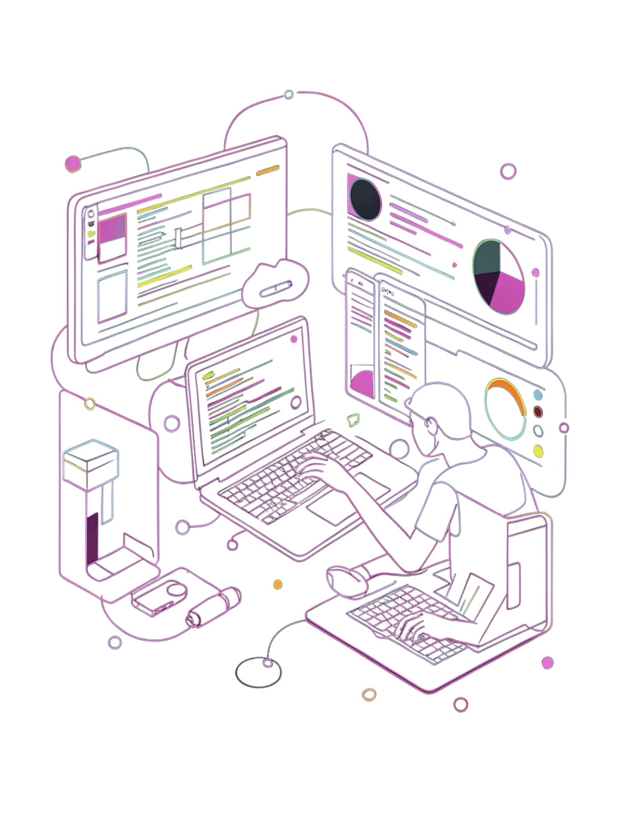



Tools and Technologies
Data Scientists use a rich ecosystem of tools — from programming languages to visualization platforms.
Programming
Python · R · SQL · Excel
Visualization
Tableau · Power BI
Development
Jupyter Notebook · VS Code
Version Control
Git

Slide 8
Fundamental Concepts & Data-Driven Decision
1
Data
Raw facts — Marks, Salary, Age
2
Information
Processed data — Average salary, Highest marks
Knowledge
3
Meaningful insights — "Students scoring below 40 require additional support"
Traditional Decisions
Data-Driven Decisions
Based on experience and assumptions — often subjective and inconsistent.
Based on facts, analysis, and evidence. Example: A restaurant owner analyzes sales reports to identify best-selling dishes instead of relying on guesswork.

Slide 9






Scope & Industry Applications
Fintech & Banking
Healthcare & Biotech
E-Commerce & Retail
Real-time fraud detection algorithms, algorithmic trading strategies, credit risk assessment models, and automated customer underwriting.
AI-assisted radiologic diagnosis, genomic sequencing analysis, predictive patient triage, and accelerated drug discovery pipelines.
Hyper-personalized recommendation engines (Collaborative Filtering), dynamic surge pricing, supply chain forecasting, and churn prediction.

Slide 10
Key Roles in the Data Ecosystem
Role | Primary Focus | Key Technical Stack | Deliverable
Data Analyst | Historical trend analysis & diagnostic reporting | SQL, Tableau, PowerBI, Excel, Stats | Executive Dashboards & Reports
Data Engineer | Architecting scalable data infrastructure & pipelines | SQL, Python, Spark, Kafka, Airflow, AWS | ETL Pipelines & Data Warehouses
Data Scientist | Statistical modeling, feature engineering & prediction | Python, R, Scikit-Learn, Pandas, Math | Predictive Machine Learning Models
ML / AI Engineer | Scaling, optimizing, and deploying AI models | PyTorch, TensorFlow, MLOps, Docker, C++ | Production API Microservices & LLMs

Slide 11
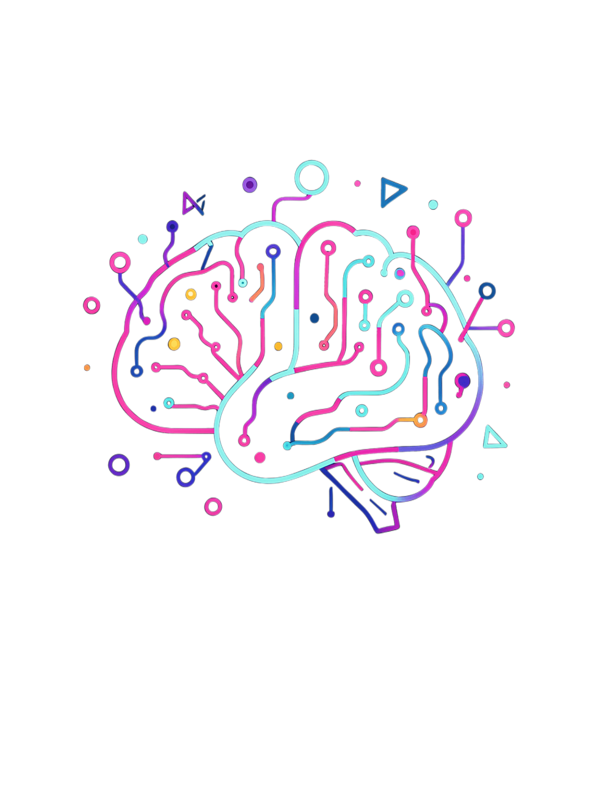
Artificial Intelligence Overview
What is Artificial Intelligence?
AI enables machines to imitate human intelligence — learning, reasoning, solving problems, and making decisions.
•
Narrow AI (ANI): Specialized AI optimized for specific tasks (e.g., chess engines, spam filters, facial recognition).
•
General AI (AGI): Hypothetical AI possessing human-level adaptability across any intellectual domain.
•
Super AI (ASI): Theoretical intelligence surpassing human capabilities across all creative and logical tasks.
AI Can
Examples in the Wild
Learn from data
Predict outcomes
Recognize images
Understand speech
Make intelligent decisions
ChatGPT
Siri & Alexa
Google Maps
Self-driving cars

Slide 12






Understanding Machine Learning
Supervised Learning
Unsupervised Learning
Reinforcement Learning
The model learns from labeled historical training datasets mapping inputs $X$ to outputs $Y$.
The model discovers hidden patterns, structures, and clusters within unlabeled data streams.
An autonomous agent learns optimal behavioral policies through trial-and-error interactions in an environment via rewards and penalties.
Tasks: Classification (spam vs ham) and Regression (predicting housing prices).
Tasks: Customer Segmentation (K-Means) and Dimensionality Reduction (PCA).
Tasks: Robotics, Self-Driving Vehicles, AlphaGo.

Slide 13


Deep Learning & Neural Networks
Subfield of Machine Learning
Key Breakthrough Domains
Deep Learning uses Artificial Neural Networks (ANNs) inspired by biological brain architectures. Multiple hidden layers automatically extract hierarchical feature representations directly from raw inputs.
Computer Vision (CNNs): Image classification, object detection, autonomous driving vision.
Natural Language Processing (Transformers): Machine translation, sentiment analysis, text generation.
Eliminates manual feature engineering for high-dimensional, unstructured data formats.
Speech Recognition: Speech-to-text synthesis and acoustic modeling.

Slide 14
The AI Hierarchy & Relationships
Artificial Intelligence (Outer Ring): The overarching discipline aiming to create smart, decision-making machines.
Machine Learning (Subset of AI): Algorithms that automatically learn and improve from data experience without explicit programming rules.
Deep Learning (Subset of ML): Deep multi-layer neural network architectures that process complex unstructured datasets (images, audio, video).
Generative AI & LLMs (Subset of DL): Advanced deep learning models (e.g., GPT-4, Llama 3) capable of generating novel text, code, audio, and synthetic images.

Slide 15
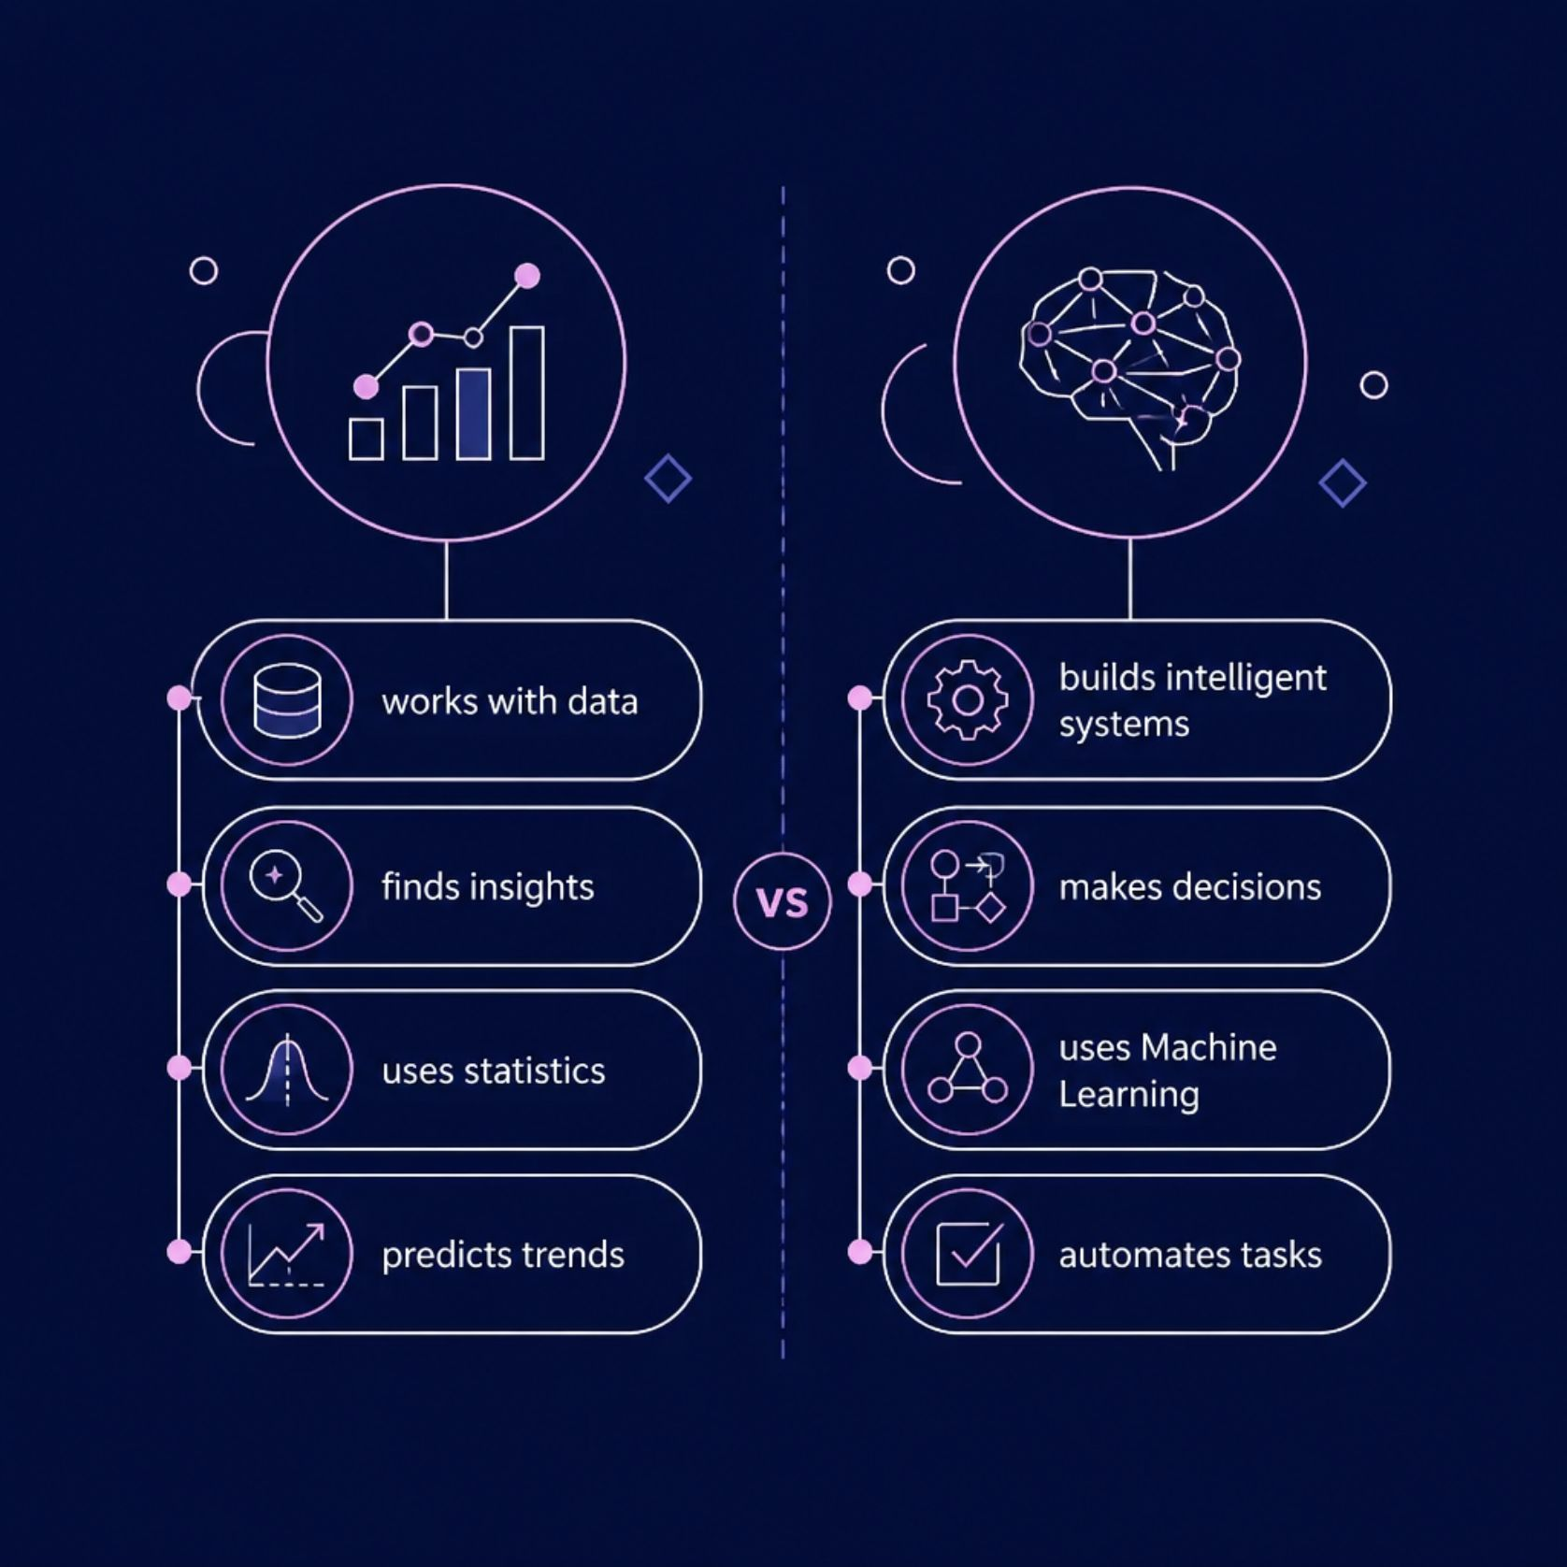

Data Science vs Artificial intelligence
How They Relate
Data Science prepares and analyzes data — uncovering patterns and trends hidden in raw information.
Artificial Intelligence uses that prepared data to learn, adapt, and make intelligent decisions autonomously.
Think of Data Science as the foundation and AI
as the intelligent structure built on top of it.

Slide 16
The Industry Impact of AI & DS
Massive Global Demand
15.7T
According to PwC and Gartner research, AI and Data Science technologies are projected to contribute up to $15.7 trillion to the global economy by 2030.
Organizations prioritizing data-driven decision workflows report 5x faster decision-making cycles and significant operational efficiency gains.
Estimated Global Economic Impact by 2030 ($)

Slide 17
Daily Practical Lab (1 Hour)
Environment Setup, Case Studies & Collaborative Discussion

Slide 18






Practical Lab Objectives
1. Workspace Setup
2. Case Study Analysis
3. Group Discussion
Launch Google Colab and set up local JupyterLab server environments with isolated Python kernels.
Analyze real-world industrial AI implementations in medical diagnostics and e-commerce engines.
Debate data ethics, bias, model hallucination, privacy compliance, and production deployment challenges.

Slide 19

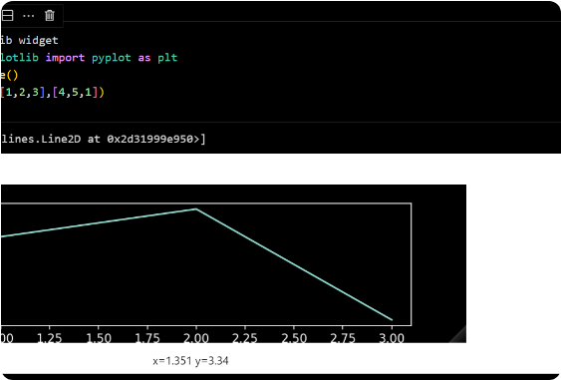
Jupyter vs. Google Colab
Interactive Notebook Paradigm
Computational notebooks combine live executable code cells, formatted Markdown text, mathematical equations, and inline data visualizations into a single reproducible artifact.
•
Google Colab: Zero-installation cloud notebook service provided by Google with free hardware accelerators (T4/A100 GPUs & TPUs).
•
JupyterLab: Web-based interactive development server for running code locally or on custom cloud server instances.

Slide 20
Step-by-Step: Google Colab Setup
Access Colab Platform: Navigate to colab.research.google.com and authenticate with your Google credentials.
Create Notebook: Click "New Notebook" to initialize an interactive .ipynb cloud environment.
Enable Hardware Accelerator: Select Runtime > Change runtime type and select T4 GPU for accelerated neural net training.
Mount Persistent Storage: Run from google.colab import drive; drive.mount('/content/drive') to connect your Google Drive datasets.

Slide 21


Local Setup: Virtual Environments
Conda Environment Management
Installing Core Scientific Packages
Creating isolated virtual environments prevents library version conflicts across different data science projects.
Execute package installation commands inside your terminal or Anaconda prompt to set up the default library suite:
conda create -n ai_env python=3.10
pip install numpy pandas matplotlib seaborn scikit-learn torch
conda activate ai_env
pip install jupyterlab
Verify installation via: import pandas as pd; print(pd.__version__)

Slide 22


The Scientific Python Stack
NumPy & Pandas
Matplotlib & Seaborn
Scikit-Learn & PyTorch
NumPy: High-performance multi-dimensional array operations and linear algebra operations.
Matplotlib: Low-level flexible plotting engine for static and custom charts.
Scikit-Learn: Industrial standard for classical ML algorithms, preprocessing pipelines, and evaluation.
Seaborn: High-level statistical data visualization library built on top of Matplotlib.
Pandas: DataFrames for tabular data cleaning, merging, filtering, and aggregation.
PyTorch / TF: Deep learning computational graph frameworks.

Slide 23
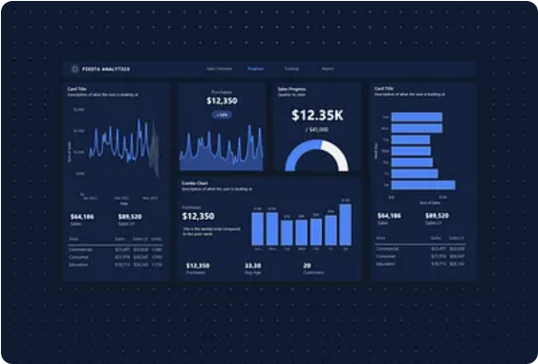
Case Study 1: AI Diagnostics in Healthcare
Radiology Image Classification
Problem Statement: Early detection of diabetic retinopathy and lung nodules from CT/MRI medical scans.
AI Solution: Deep Convolutional Neural Networks (ResNet/DenseNet) trained on thousands of annotated radiological scans.
Impact & Value: Reaches 94%+ diagnostic accuracy, reducing clinician triage processing time from days to seconds.

Slide 24


Case Study 2: Recommendation Systems
Personalization Engine Architecture
Business Metric Impact
Collaborative Filtering: Recommends items by finding similarity vectors between user browsing behaviors ("Users who bought X also bought Y").
Real-World Impact: Up to 35% of Amazon sales revenue and over 80% of Netflix watch hours are driven directly by automated recommendation algorithms.
Content-Based Filtering: Matches item metadata attributes (genre, price point, category) directly to user preference profiles.
Dramatically improves user retention rates and customer lifetime value (LTV).

Slide 25
Group Discussion & Ethical AI
Algorithmic Bias & Fairness: How do historical training datasets introduce gender, racial, or socioeconomic bias into automated hiring and loan approval models?
Data Privacy & GDPR: What are the ethical implications of scraping user web data without explicit consent for AI model training?
Model Explainability (XAI): In high-stakes fields like healthcare and justice, when should black-box Deep Learning models be replaced with interpretable models?
AI Safety & Hallucination: How can engineering teams validate Generative AI outputs when models confidently present false information as fact?

